Slide 1
Data Science Implementation With Computer Vision
Dataops Implementation Concept Explanation.
Naveen V

Slide 2
Dataops Functionalities
Dataset Preparation(ETL)
Data Quality Check
Model Quality Check
Version Control with GitHub
Data Integration with Cloud(Docker and Kubernetes)

Slide 3
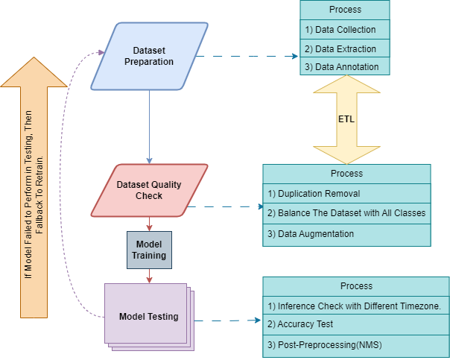
Dataops Step-1

Slide 4
Dataops Process-1
Follow ETL Rules
Dataset Preparation :
Data Collection from client
Data Extraction
Data Annotation
2) Dataset Quality Check:
Duplication Removal with Python Script.
Balance the dataset equally with All classes.
Data Augmentation.

Slide 5
Dataops Process-1
After Model Training.
Model Testing:
Inference Check with Different Timezone and Environment like,
Different Lighting - Morning, Evening and Night.
Foggy and High Level Brightness Environments, etc.
Model Accuracy analysis,
Accuracy and Classification Metrics
mAP, Precision, Recall, IoU(Intersection over union), F1-score.
Visual Inspection
Heatmap Generation with each classes.
Post Pre-Processing
NMS(Non-Maximum Suppression)

Slide 6
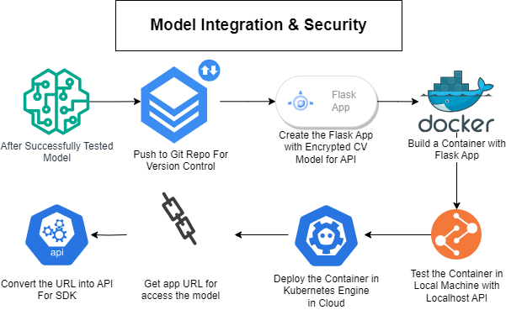
Dataops Process-2

Slide 7
Dataops Step-2
After successfully testing the model, push it to the respective project repository.
Create a Flask application with the model to enable access through an encrypted API. Without storing the model locally, the goal is to run the model in RAM memory and integrate it into our SDK for execution.
Build a Docker container for our encrypted API Flask application. Test it locally with inference.
After successfully testing the Docker container, deploy it in the Kubernetes Engine in the cloud.
Once successfully deployed in the Kubernetes Engine, obtain the URL, test it locally, and convert the URL into an API.
Finally, deliver the API to the implementation team. This process will be continued as CI/CD pipeline.

Slide 8
Pros & Cons
Pros:
We have a perfectly tested and running model.
Our model is not stored on our client's system, enhancing its security.
We maintain model versioning control using Git.
Implementation of continuous integration (CI) and continuous deployment (CD).
Utilizing the Kubernetes URL for automating our annotation process with Label Studio or other tools.
Cons:
A client system must have an internet connection.
There are associated cloud service costs.

Slide 9
Thank you!

